Slide 1
COM-FSM
Student Body Association
Report to the Board of Regents
Thursday, April 2, 2020
Via Zoom

Slide 2
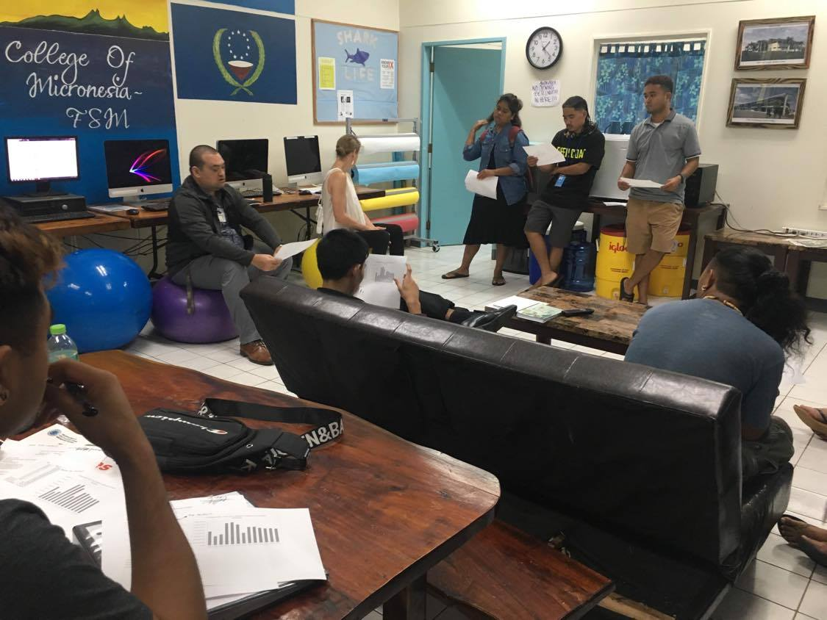
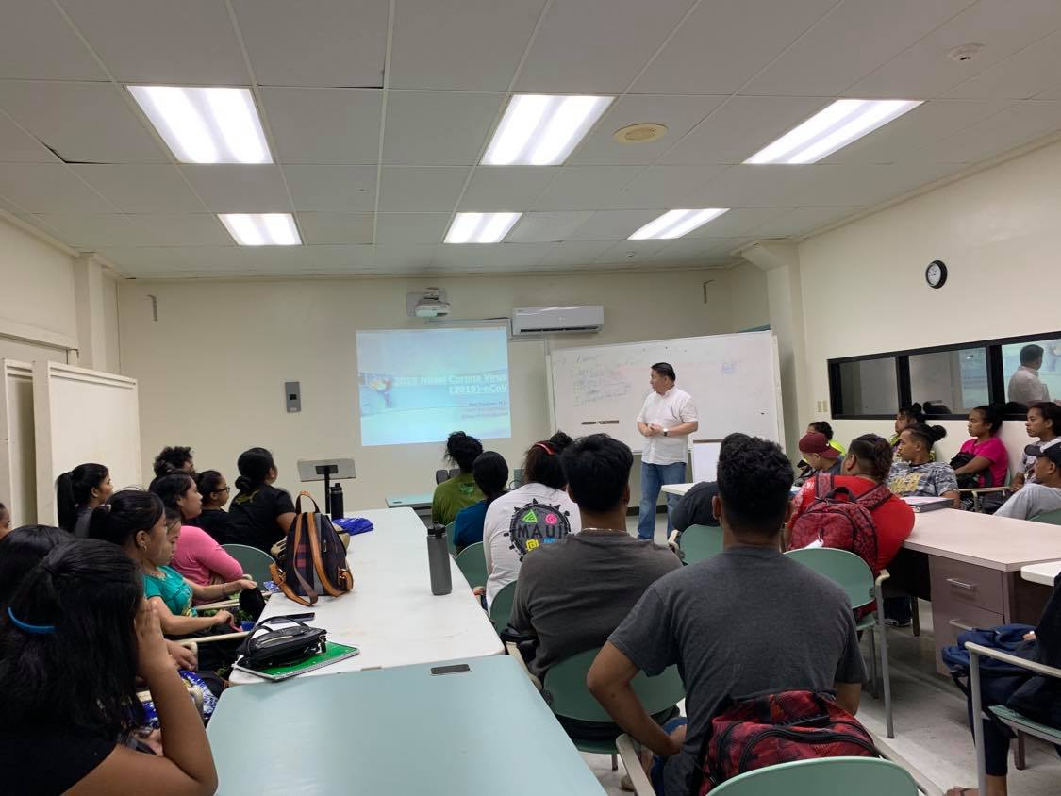
National Campus Updates
Student Council Meetings
Forum Lectures

Slide 3
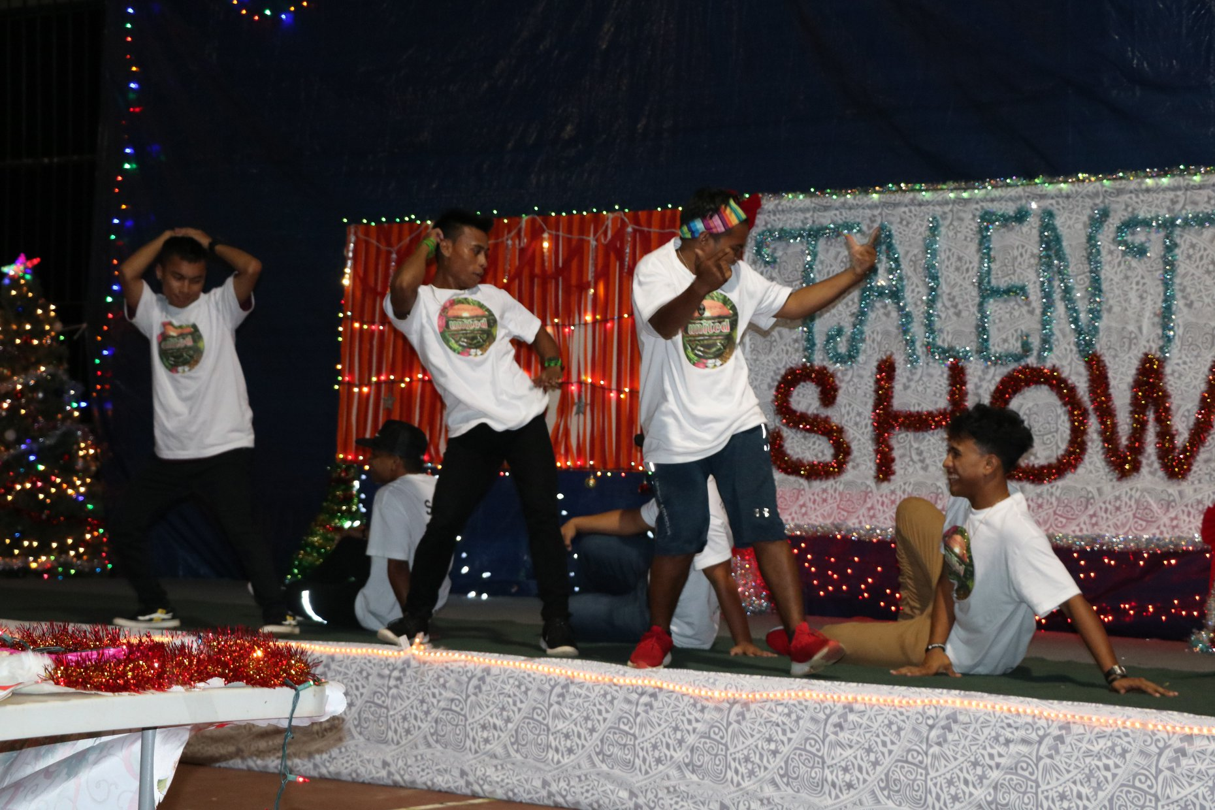
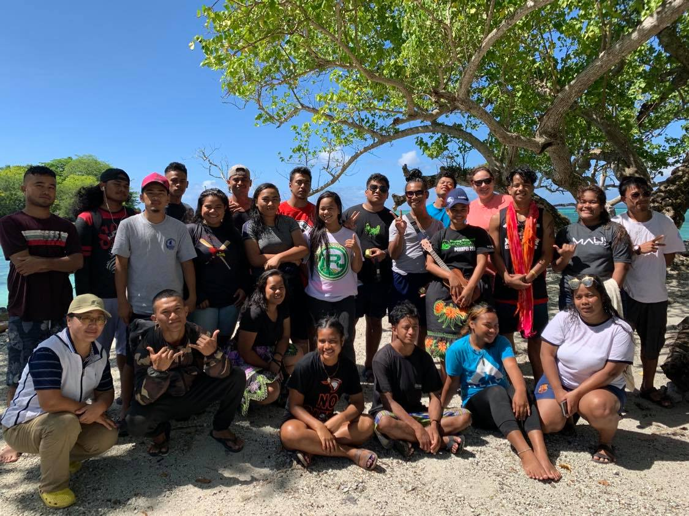
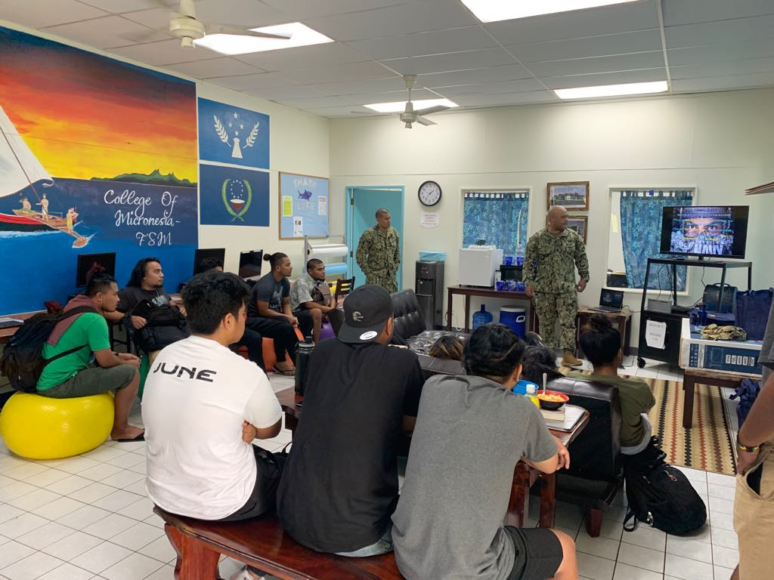
CTEC & National
Campus Collaborative Updates
Talent Show
Scholarship Forums
Student Council Retreat

Slide 4
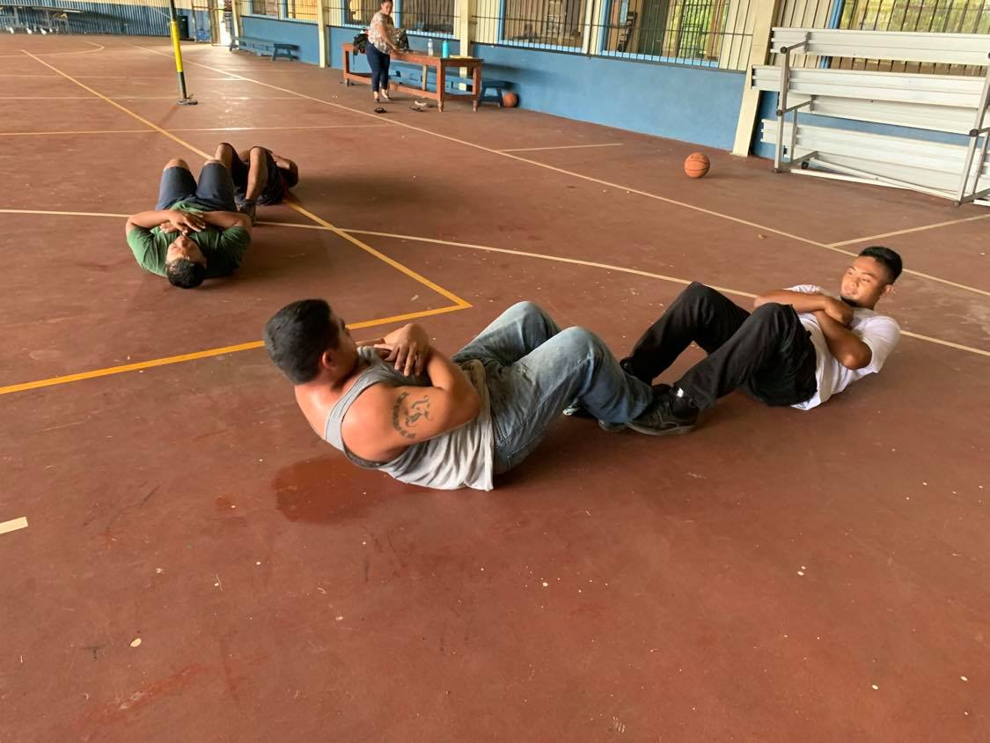
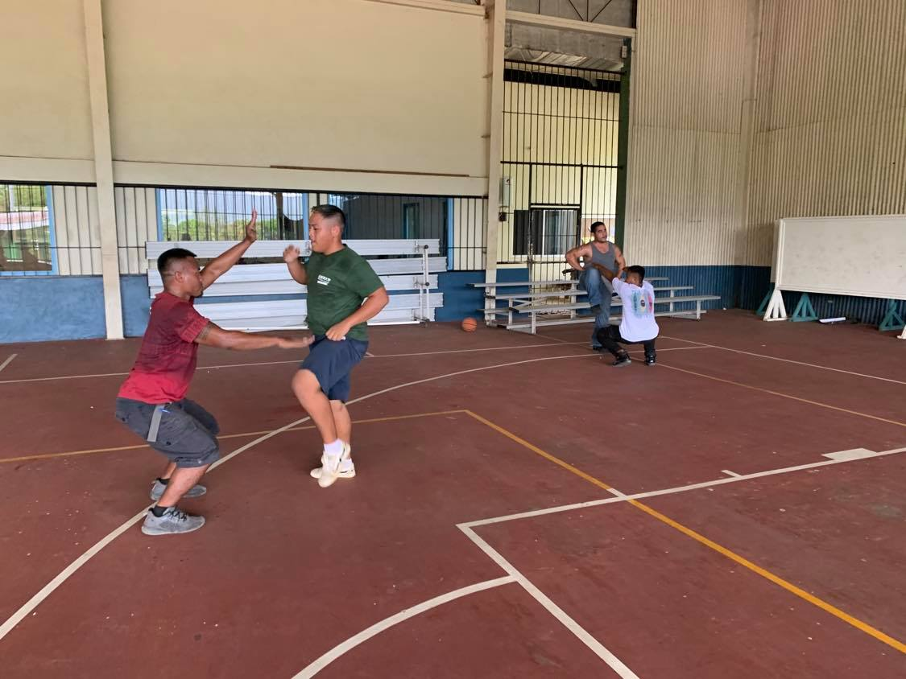
CTEC Updates
Student Council Meetings
Wellness Activities

Slide 5
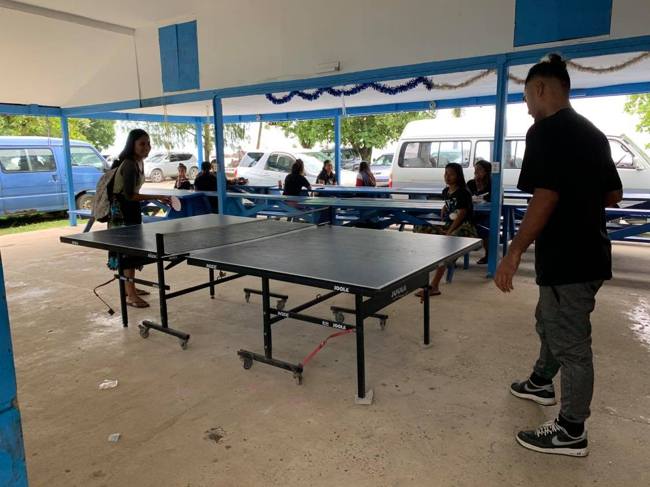
Chuuk Campus Updates
Student Council Meetings
Updates to Student Lounge

Slide 6
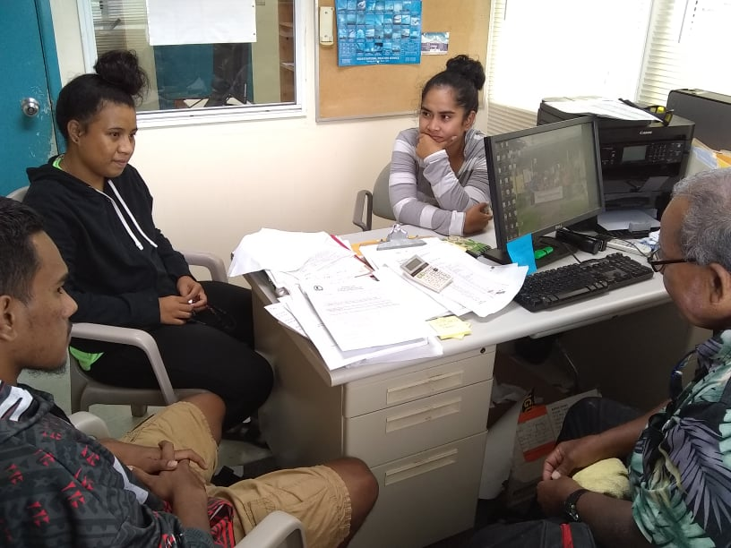
Kosrae Campus Updates
Student Organizations
Student Council Meetings
Village Huts

Slide 7
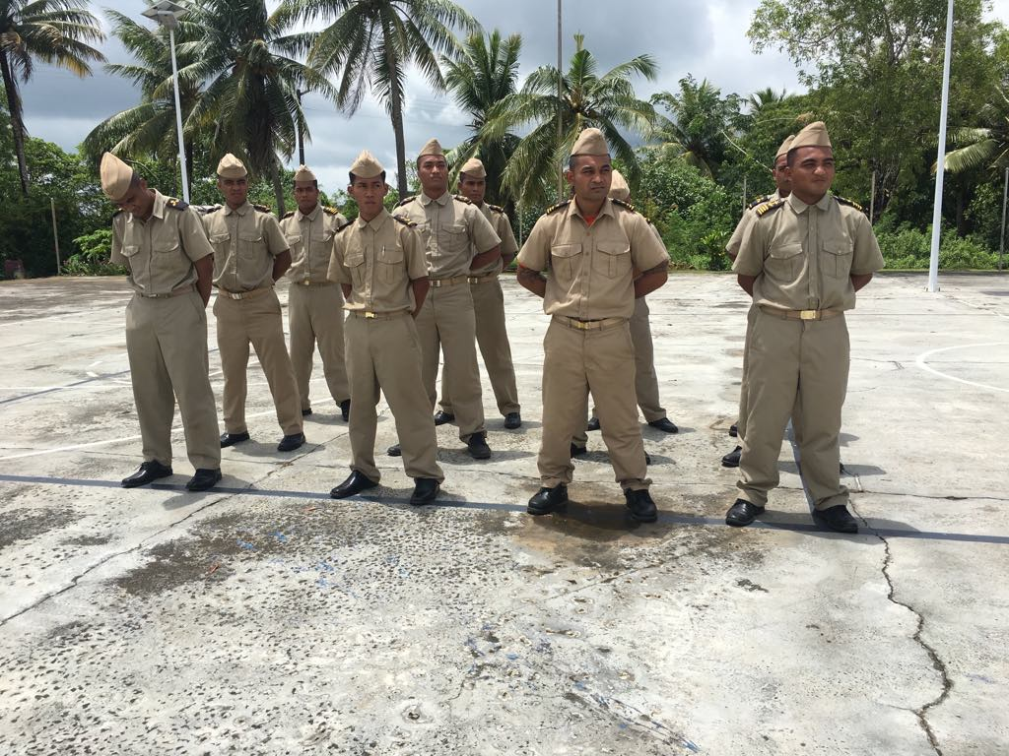
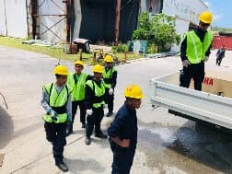
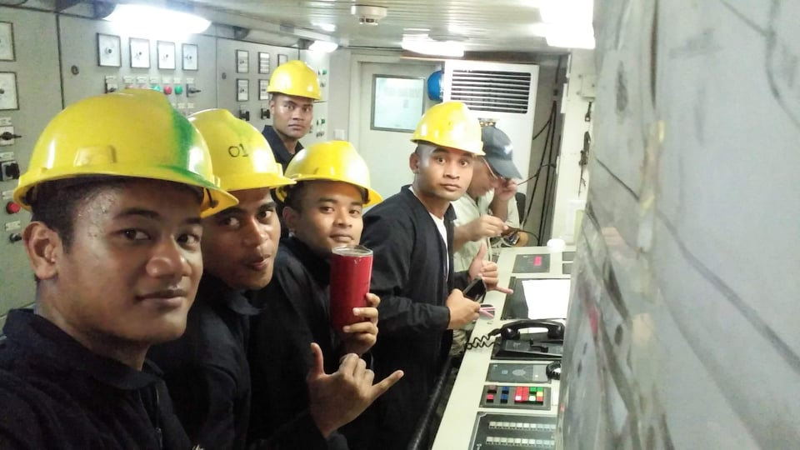
FSM-FMI Updates
Shipboard Training
Weight Room Updates

Slide 8
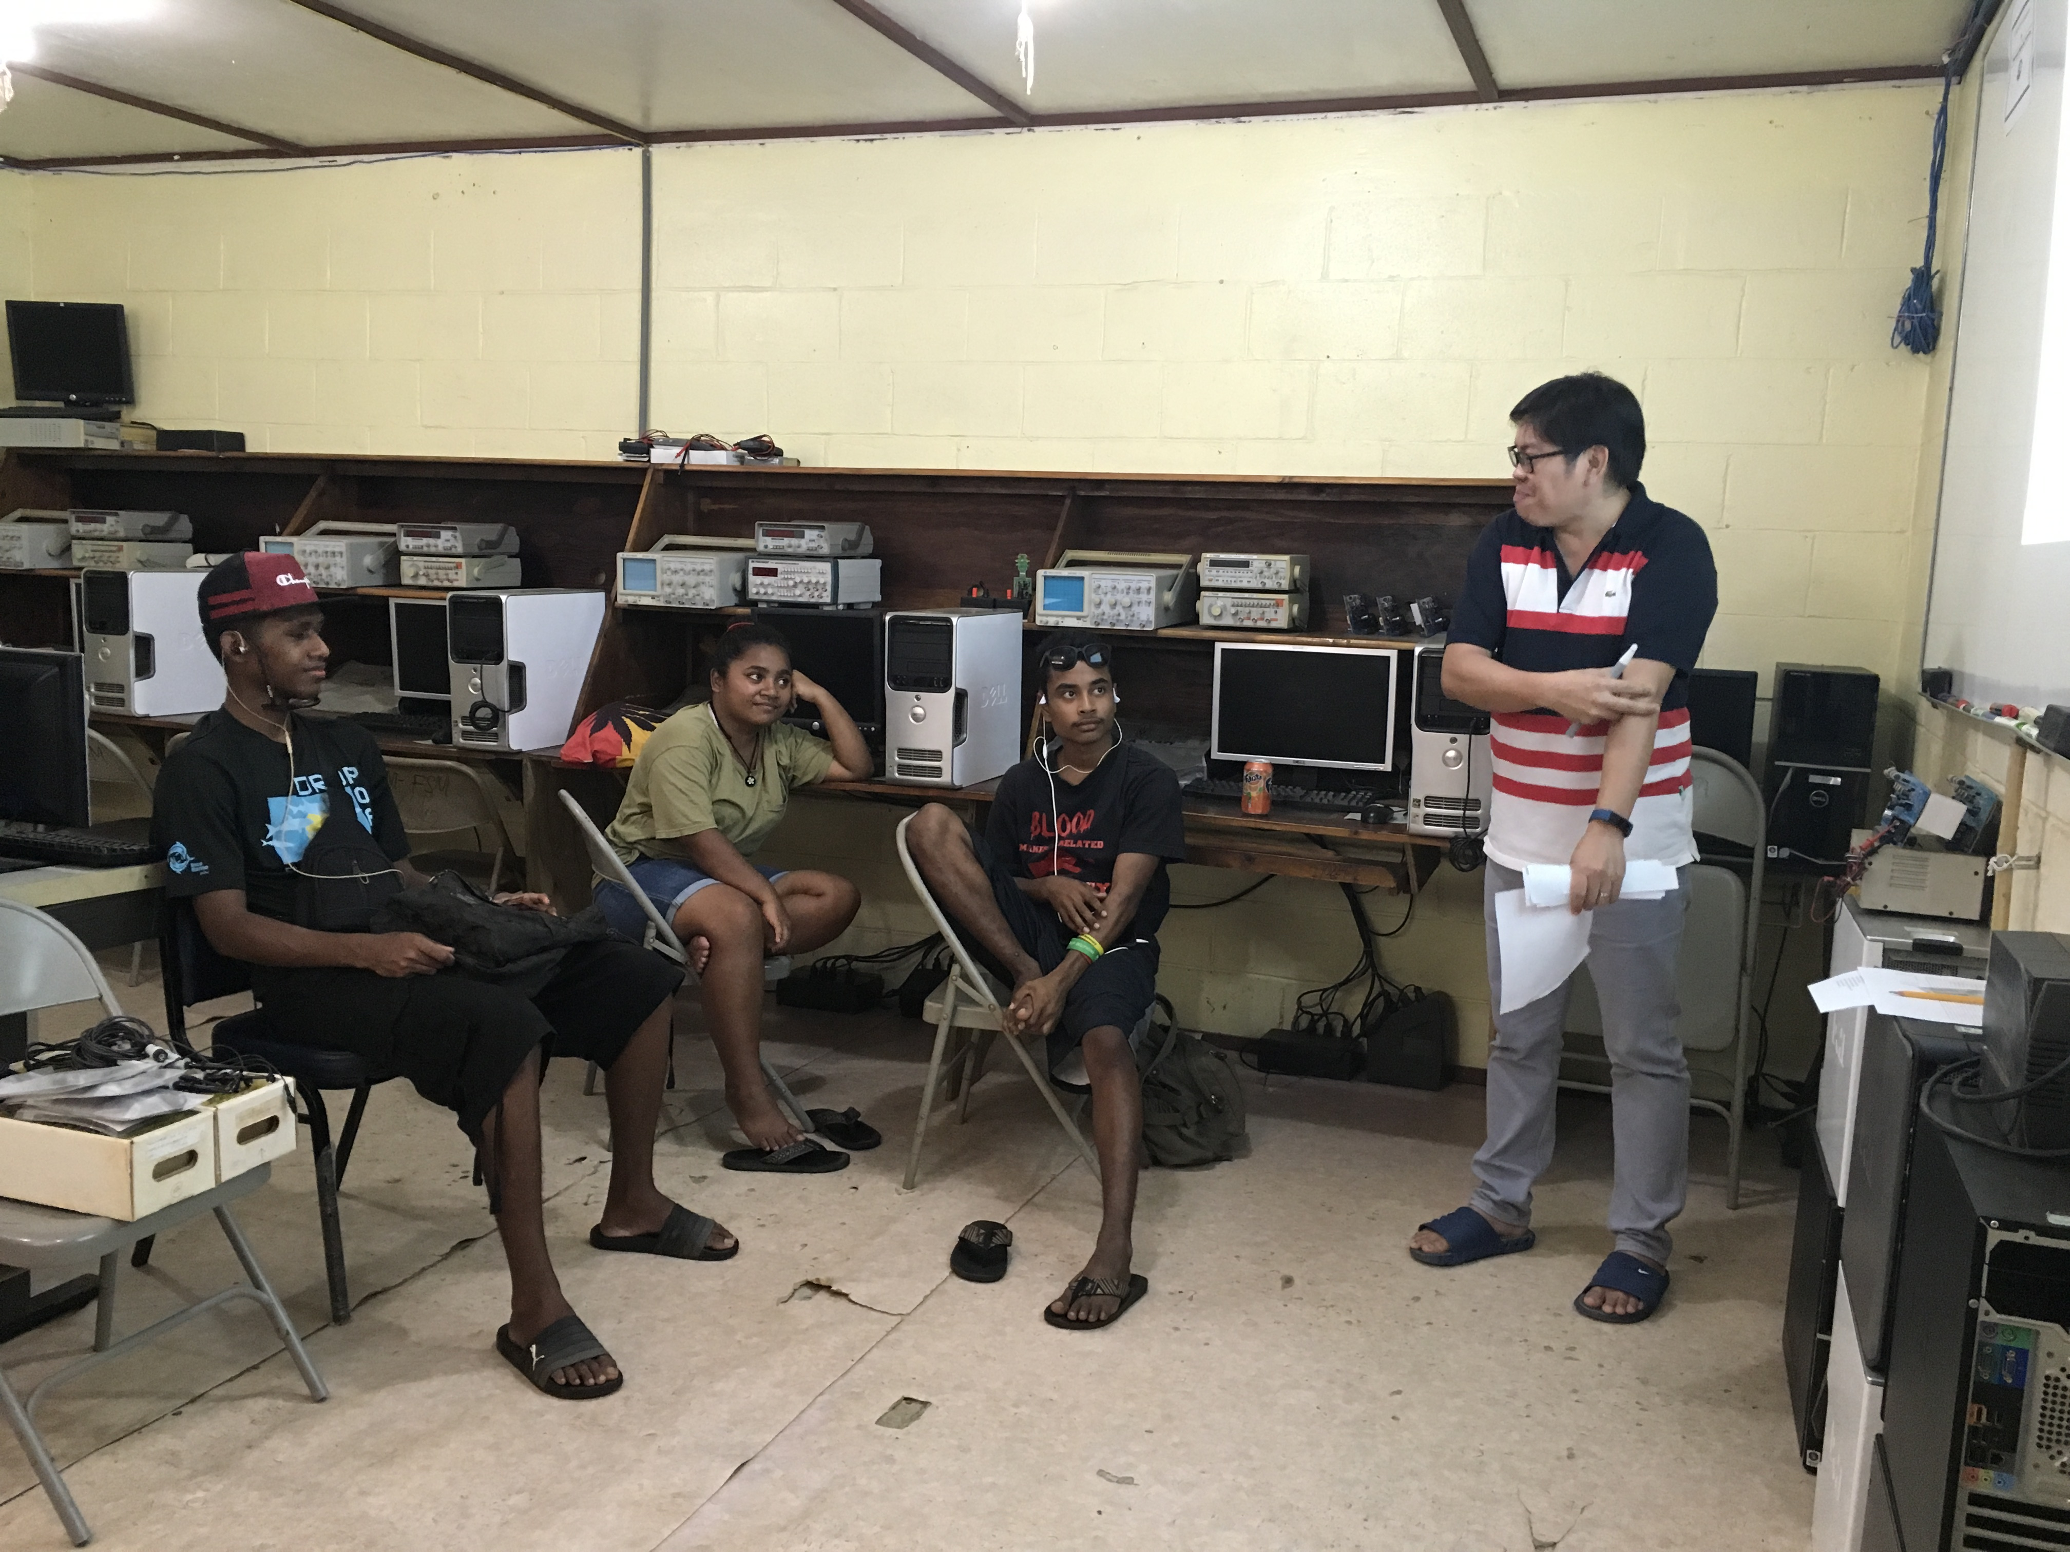
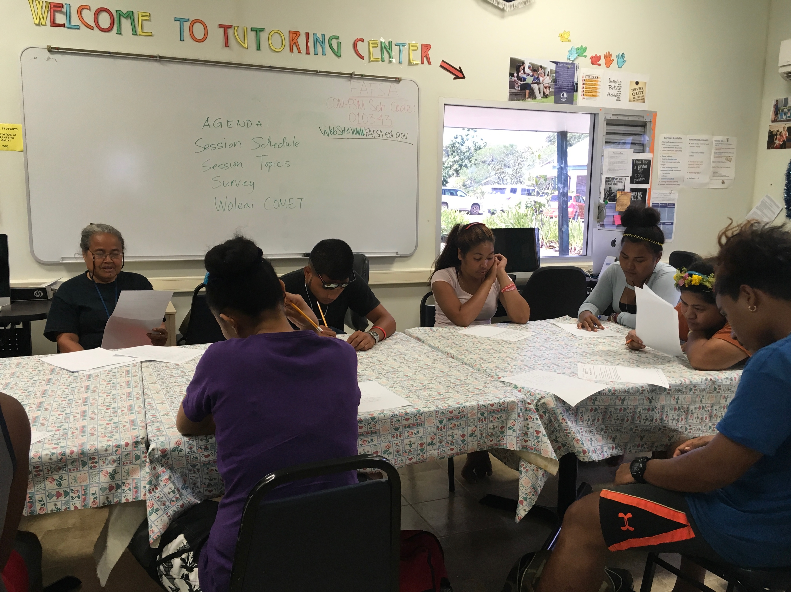
Yap Campus Updates
Campus Powwows

Slide 9
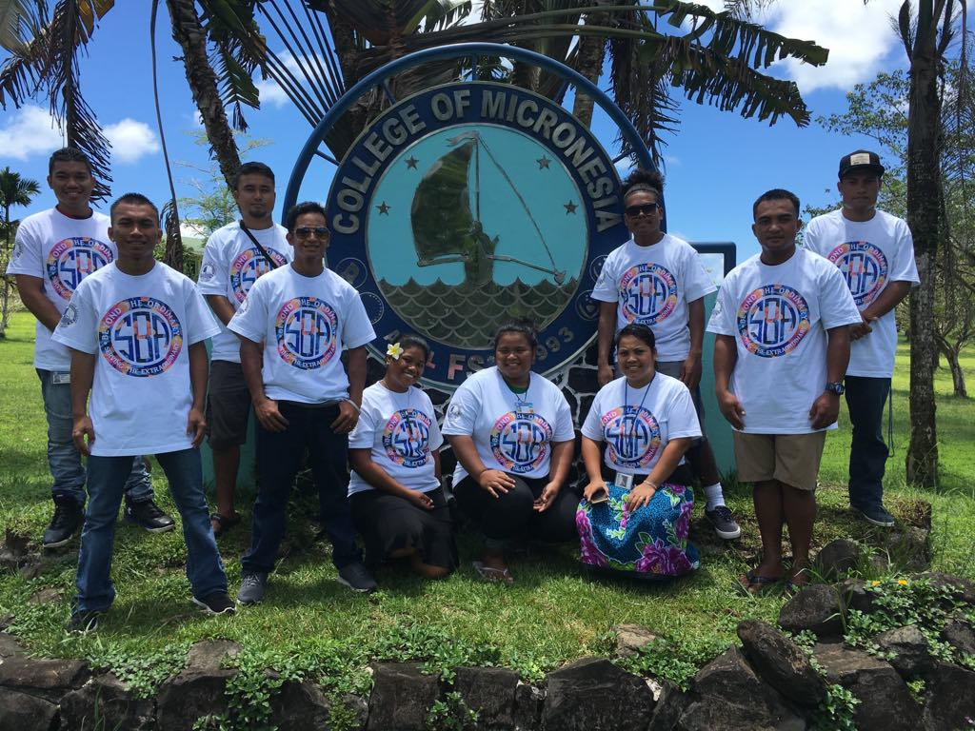
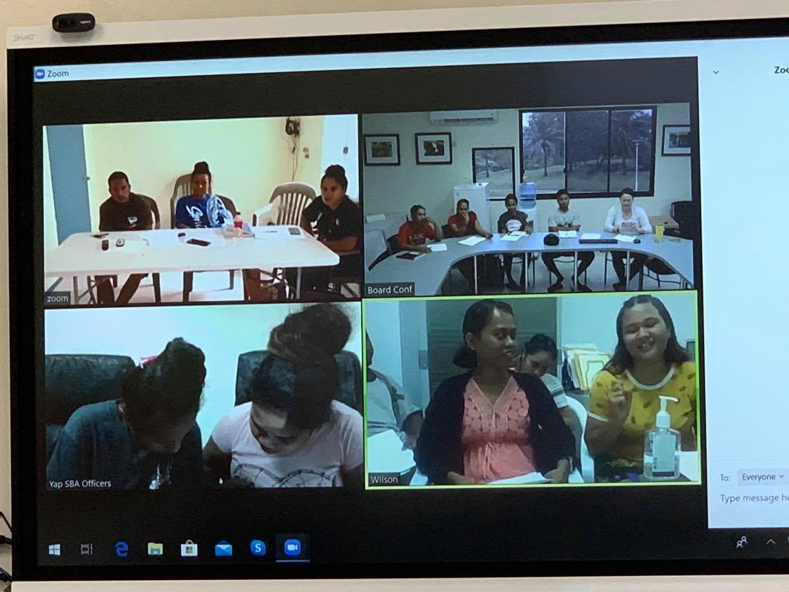
Moving Forward
Digital Communications
Notes:
We will be doing our best to hold a digital meeting via Facebook messenger on Friday afternoon to check in with all officers.

Slide 10
THANK YOU!!
Notes:
Stay safe, stay healthy & wash your hands!

